Slide 1
by: Harshal Chaudhari (MSE2022009) Ganesh Pipare (MSE2022013) Supervised by: Dr. Omkarendra Tiwari
Driver’s Sleepiness Alert System

Slide 2
Content
2
Introduction
Product Scope
Intended Audience
User Requirements
Functional Requirements
Non-Functional Requirements
Software Flow Diagram
Use Case Diagram
Class Diagram
Prototype
References

Slide 3
Introduction
3
According to Ministry of Road Transport and Highways In 2020, there were 366,138 road accidents in India. These accidents resulted in the deaths of 131,714 people and caused injuries to 348,279 others. [1]
In 2021, there were 4,12,432 road accidents in India. These accidents resulted in the deaths of 1,53,972 people and caused injuries to 3,84,448 others. [1]
There are many causes of accidents some of which are
Distracted driving
Speeding
Driving under the influence of alcohol or drugs
Reckless driving
Poor road conditions
According to a research done by National Highway Traffic Safety Administration (NHTSA) Data shows that 2.4 percent of all fatal car accidents involve drowsy drivers. [2]

Slide 4
Product Scope
4
The software product scope of a sleepiness detection system involves the development of components that can accurately analyze data from cameras to detect signs of sleepiness.
It also includes features such as alerts, warnings, custamization. The software product scope is focused on providing a accurate detection of sleepiness.

Slide 5
Intended Audience
5
Transportation industry: The transportation industry, including commercial trucking companies, taxi and ride-sharing services, and public transit agencies, could benefit from sleepiness detection systems to help keep their drivers and passengers safe on the road.
General public: The general public could benefit from sleepiness detection systems during long drives, late-night shifts, or while operating heavy machinery.

Slide 6
User Requirements
6
A sleepiness detection system is a technology designed to monitor a person's level of alertness and detect signs of sleep.
Below are some possible user requirements of a sleepiness detection system
Accuracy: The system should be accurate in detecting sleepiness and should not give false alarms.
Alert mechanisms: The system should use appropriate alert mechanisms, such as light beeping or alarm, to notify the driver when sleepiness is detected.
Real-time monitoring: The system should monitor the driver’s alertness in real-time, without causing distraction.
Customizable settings: The system should allow users to customize settings, such as sensitivity levels and alert types.
Data reporting: The system should report data related to sleepiness events, such as time, and severity, to help driver understand his/her patterns and take appropriate measures.

Slide 7
Functional Requirements
7
Functional requirements are necessary features and abilities that a sleepiness detection system must have to work correctly and efficiently.
Below are some possible functional requirements of a sleepiness detection system
Monitoring: The system should continuously monitor the driver’s behavior and alertness levels to detect signs of sleepiness.
Analysis: The system should analyze the face data, such as eye movements, to determine the driver’s level of sleepiness in real-time.
Alerting: The system should provide appropriate alerts to the driver when sleepiness is detected, such as light beeping or alarm.
Customization: User should be able to modify the alerting mechanism, such as alarm audio.
Data collection: To improve its effectiveness, the system is required to gather information on how awake the user is, this can be studied to improve the system.

Slide 8
Non-Functional Requirements
8
Non-functional requirements refer to the qualities or characteristics that a drowsiness detection system should have, but do not relate to its primary function.
Below are some possible non-functional requirements of a sleepiness detection system
Safety: The sleepiness detection system must prioritize safety as the most important non-functional requirement. The system must be able to accurately detect sleepiness in the driver and provide timely alerts to prevent accidents. The system should also be designed to minimize false positives or false negatives, as they can also pose a risk to safety.
Reliability: The drowsiness detection system must be reliable, with a high level of availability, performance, and accuracy. The system should be able to operate continuously without failure and provide accurate and consistent results over time.
Usability: The drowsiness detection system must be easy to use and user-friendly. It should not require extensive training or specialized knowledge to operate. The system should also provide clear and understandable alerts to the driver, with intuitive user interfaces.

Slide 9
Non-Functional Requirements
9
Scalability: The drowsiness detection system should be scalable and able to support different types of vehicles and driving conditions. It should also be able to handle large volumes of data and provide real-time analysis and feedback.
Maintainability: The drowsiness detection system should be easy to maintain and update. The system should be designed with modularity and flexibility in mind, allowing for easy upgrades and modifications.

Slide 10
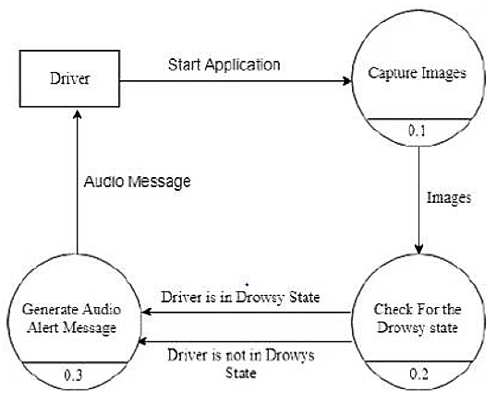
Software Flow Diagram
10

Slide 11
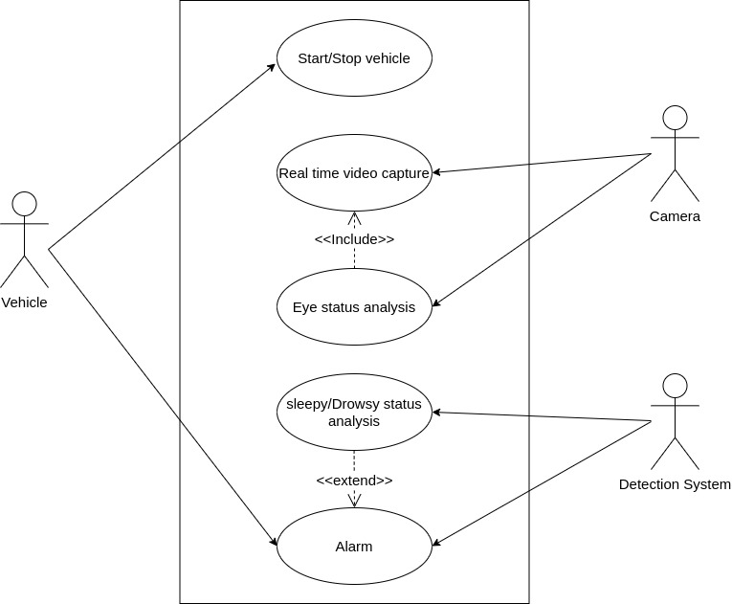
Use Case Diagram
11

Slide 12
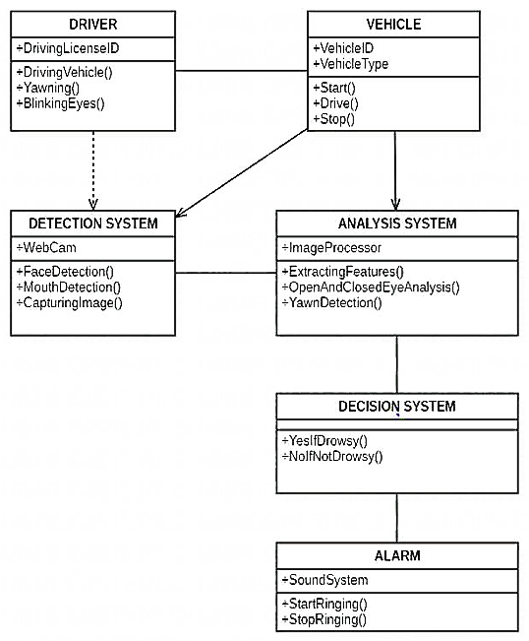
Class Diagram
12

Slide 13
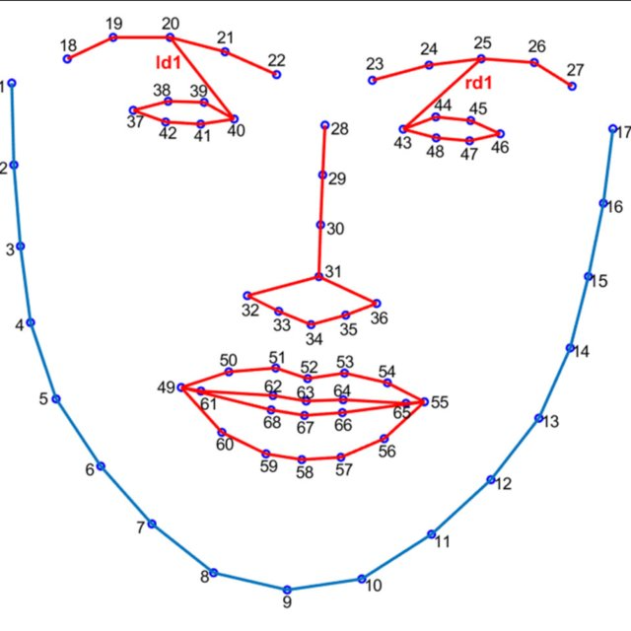
Methodology
13
OpenCV: The camera is initialized using OpenCV and the
instance is taken for further processing
Dlib: The face detector and landmark detector are initialized
using Dlib library and the shape predictor file
"shape_predictor_68_face_landmarks.dat".
numPy: The facial landmarks are detected using the landmark
detector, and the detected landmarks are converted to
NumPy arrays for further processing
shape_predictor_68_face_landmarks [3]

Slide 14
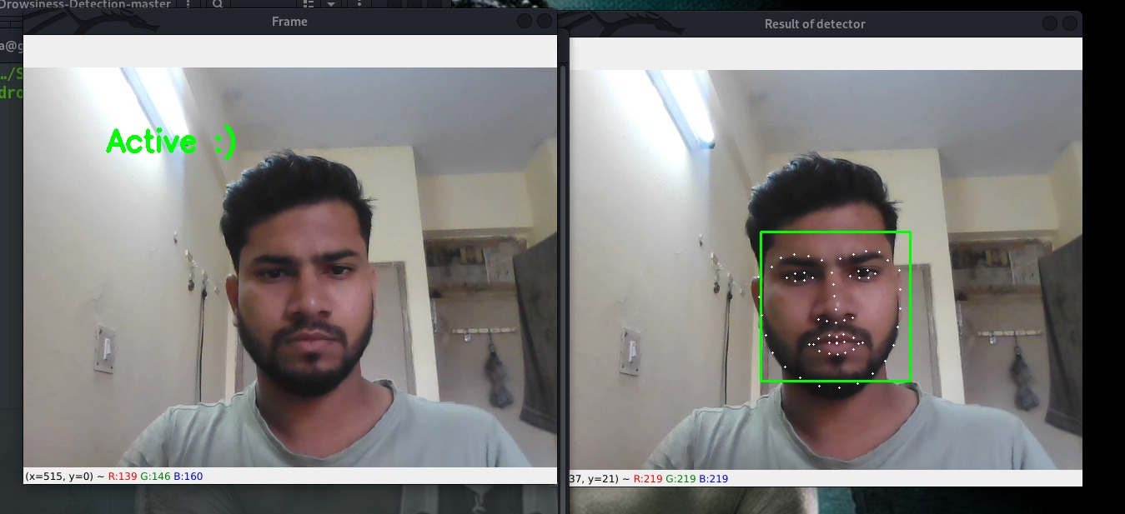
Prototype
14

Slide 15
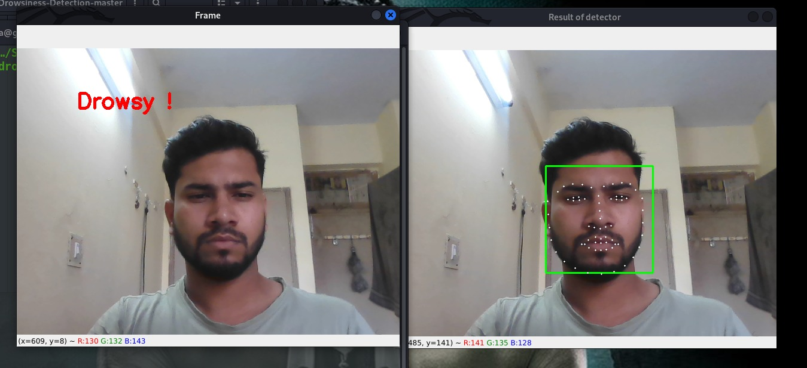
Prototype
15

Slide 16
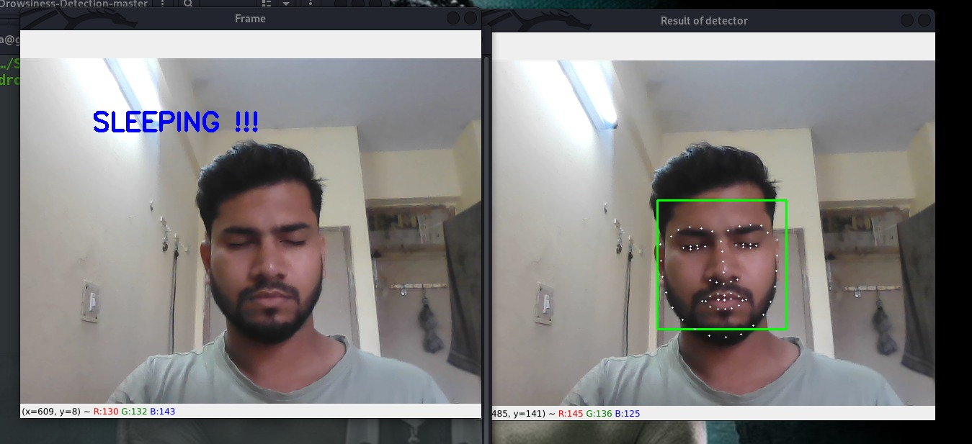
Prototype
16

Slide 17
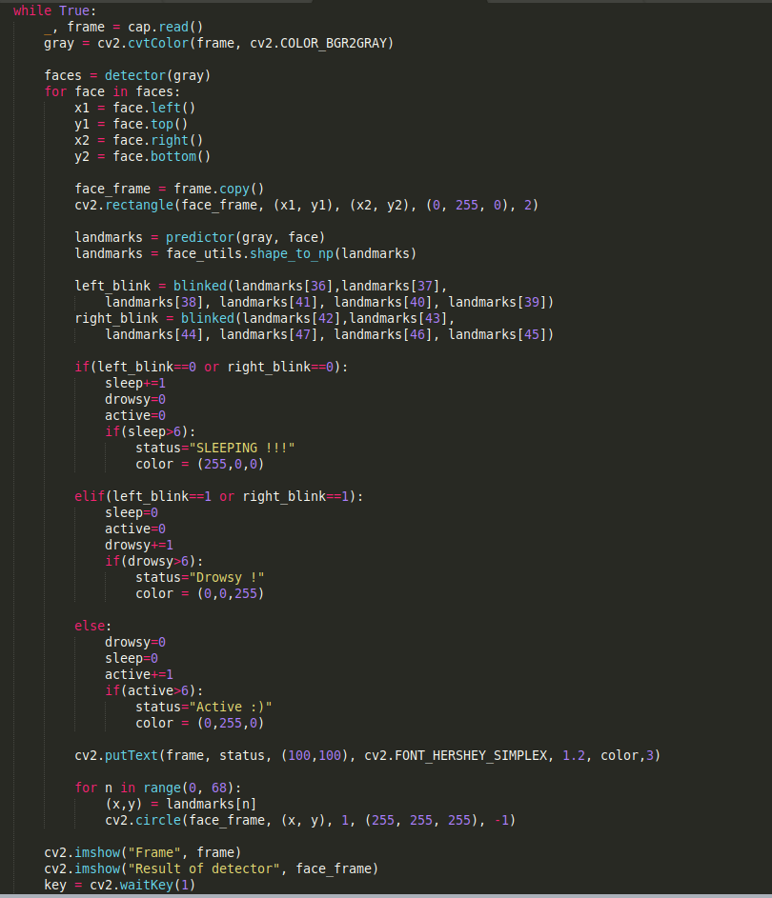
Prototype Code
17

Slide 18
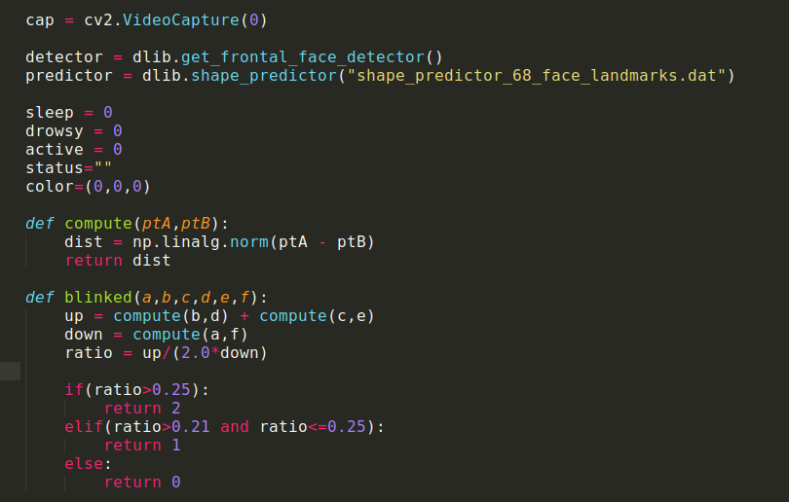
Prototype Code
18

Slide 19
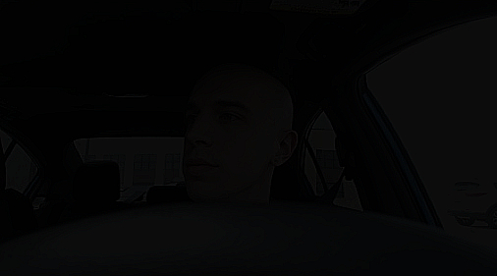
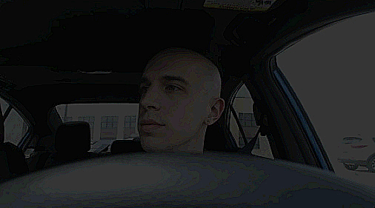
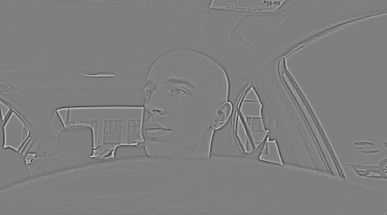
Prototype
19
Original
Brighten
Grey Scale

Slide 20
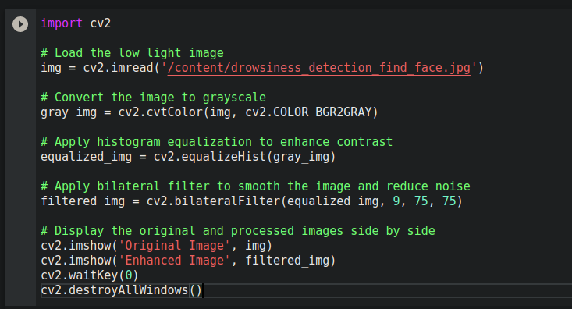
Prototype Code
20

Slide 21
References
21
[1] Ministry of Road Transport and Highways, Government of India
Road Accidents in India.
https://morth.nic.in/road-accident-in-india
[2] National Highway Traffic Safety Administration (NHTSA). (2018).
Topic: Drowsy Driving
https://www.nhtsa.gov/risky-driving/drowsy-driving
[3] Chrysos, G. G., & Karpouzis, K. (2017). Deep Learning for Computer Vision
Computational Intelligence and Neuroscience, 2017, 1-13. doi: 10.1155/2017/1308521.
http://dlib.net/files/shape_predictor_68_face_landmarks.dat.bz2

Slide 22
22
Thank You.

